Slide 1
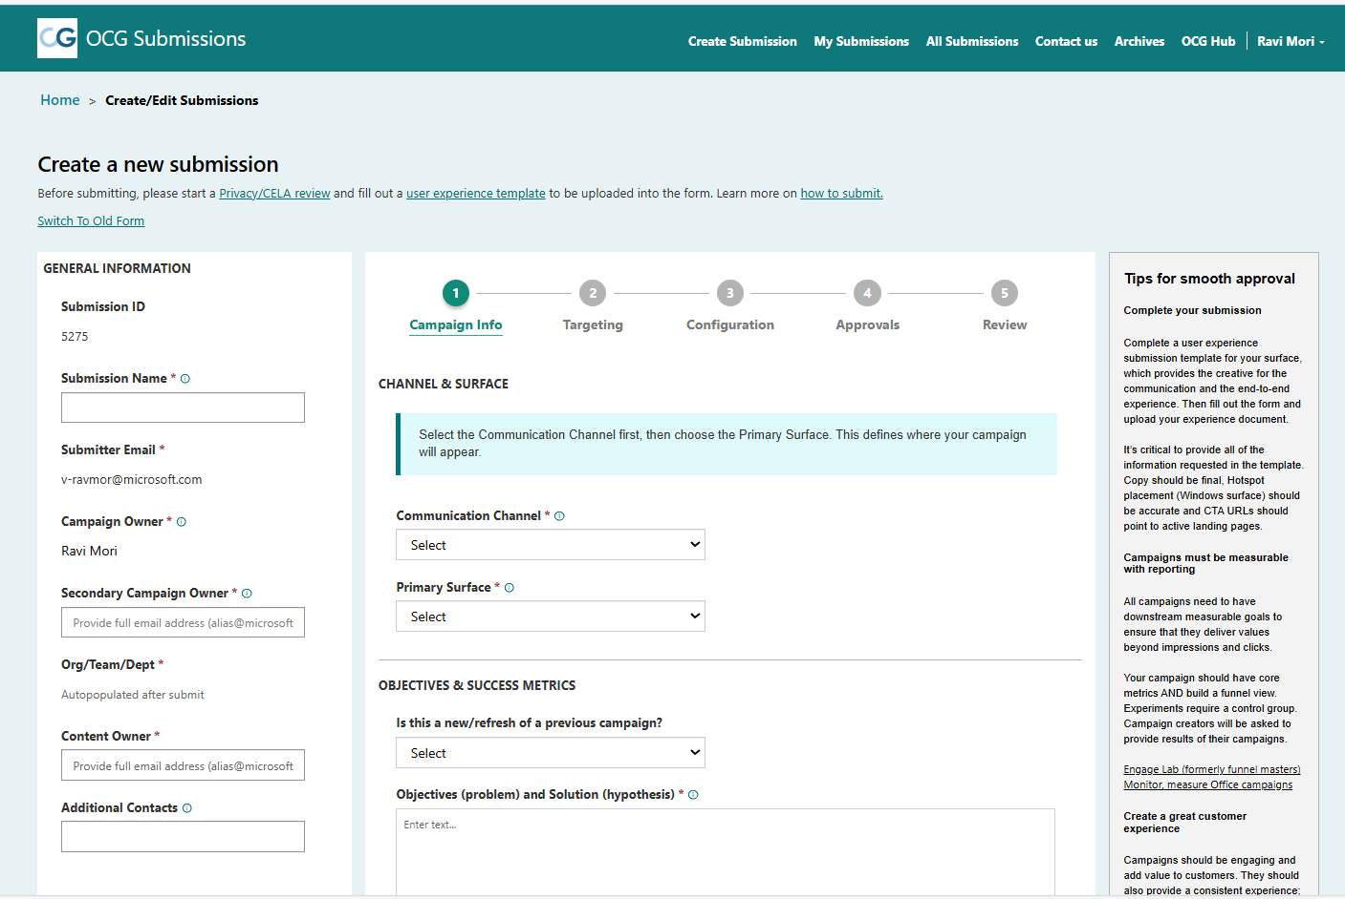

Microsoft OCG Campaign Submission Portal
Overview
The Office Communications Governance committee reviews and approves all proposed campaigns targeting Office users on various surfaces. The submission portal is a centralized platform for review, triage, and approval of all M365 communications.
Affirma Deliverables
Client was using Power App embedded in SharePoint.​
On Power App form submission, record gets inserted in SharePoint list and using Power Automate it was syncing with Dynamics365 (backend admin management) as well.​
Due to challenges in embedded power app, we had suggested to go with Power App Portal (Now called Power Pages)​
Removed dependency of using SharePoint list and now SharePoint is only getting used for storing files.​
Using Power Pages, customization is very quick, and we can easily add/remove fields and some more sections.​
We have integrated Microsoft Teams with D365 using Power Automate for this project.​
Migrated all archived data into D365 from SharePoint list.
Office Communications Governance - Home

